Slide 1
CAPSTONE PROJECT
PROJECT TITLE
Presented By:
1. Jaleena-Anna University(ACT campus)- Center for Biotechnology(Pharmaceutical technology)

Slide 2
OUTLINE
Problem Statement
Proposed System/Solution
System Development Approach
Algorithm & Deployment
Result
Conclusion
Future Scope
References

Slide 3
PROBLEM STATEMENT
To analyze the data set contains booking information for a city hotel and a resort hotel, and includes information such as when the booking was made, length of stay, the number of adults, children, and/or babies, and the number of available parking spaces, among other things and discover important factors that govern the bookings.

Slide 4
PROPOSED SOLUTION
Utilizing advanced machine learning algorithms, our solution will analyze extensive historical hotel booking data to establish patterns and correlations.
For optimal timing, a predictive model will consider factors such as seasonality, demand fluctuations, and promotional periods, providing users with insights on when to secure the most cost-effective room rates.
The ideal length of the stay will be determined through data-driven analysis, considering variables like day-of-week trends and duration-specific pricing strategies.
Additionally, a specialized model will predict the likelihood of hotels receiving elevated special requests by examining guest profiles, reservation details, and hotel amenities, enabling proactive management strategies for enhanced customer satisfaction.
This holistic approach aims to empower travelers and hoteliers alike with actionable intelligence for strategic decision-making in the dynamic hospitality landscape.

Slide 5
SYSTEM APPROACH
Building the proposed solution would involve a combination of data processing, feature engineering, and machine learning.
Here are the key system and library requirements.
System Requirements:
Hardware:
A computer with sufficient processing power, preferably with multiple cores or a GPU for faster training of machine learning models.
Adequate RAM to handle the size of the dataset and computational requirements.
2. Software:
An operating system compatible with the required machine learning libraries(e.g., Windows, Linux, macOS).

Slide 6
SYSTEM APPROACH
Library Requirements:
Data Processing and Analysis:
Pandas: For data manipulation and analysis.
Numpy: For numerical operations on data.
2. Data Visualization:
Matplotlib and Seaborn: For creating visualizations to understand data patterns.
Plotly or Bokeh: Interactive visualization libraries for more complex visualizations.

Slide 7
ALGORITHM & DEPLOYMENT
Algorithm Selection
Data Exploration:
Explore the hotel booking dataset’s structure, features, and target variable(s).
Identify potential patterns, correlations, and outliers.
Problem Formulation:
Define the problem: Predict the major factors affecting bookings such as preferred room type, preferred meal type, and number of bookings across year and month.
Algorithm Selection:
Regression tasks : Consider linear regression, decision trees, or ensemble methods.
Classification tasks: Consider logistic regression, decision trees, or random forests.

Slide 8
ALGORITHM & DEPLOYMENT
Data Input:
Data Collection:
Gather historical hotel booking data, including information on booking dates, length of stay, special requests, guest profiles, and relevant hotel details.
Data Cleaning:
Handle missing values, outliers, and any inconsistencies in the dataset.
Convert categorical variables into numerical representations through encoding techniques.
Feature Engineering:
Create new features or modify existing ones based on domain knowledge.
Extract meaningful information from date variables, such as dry-of-week or month.

Slide 9
ALGORITHM & DEPLOYMENT
Training Process:
Data Splitting:
Divide the dataset into training and testing sets to evaluate the model’s performance.
Feature Scaling:
Standardize or normalize numerical features to ensure they have a consistent scale.
Model Training:
Use the selected algorithm to train the model on the training dataset.
Adjust hyperparameters to optimize model performance.
Model Evaluation:
Evaluate the model on the testing dataset using appropriate metrics (e.g., Mean Squared Error for regression, accuracy, precision, recall for classification).
Fine-tune the model if necessary.

Slide 10
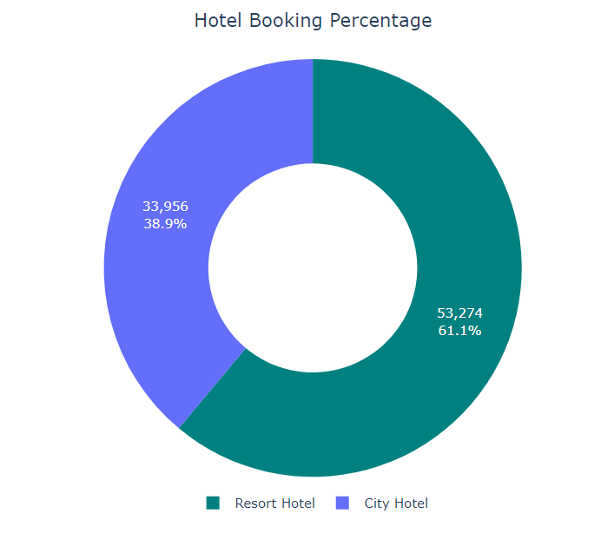
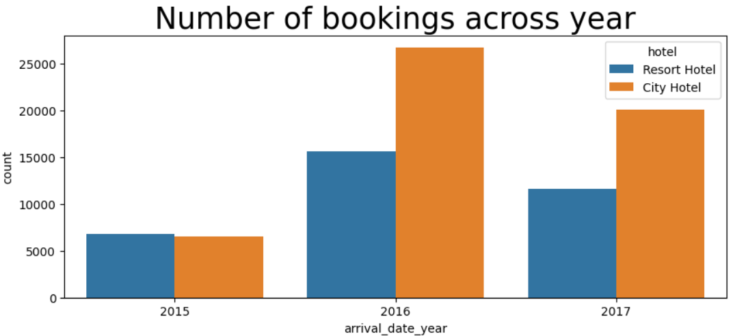
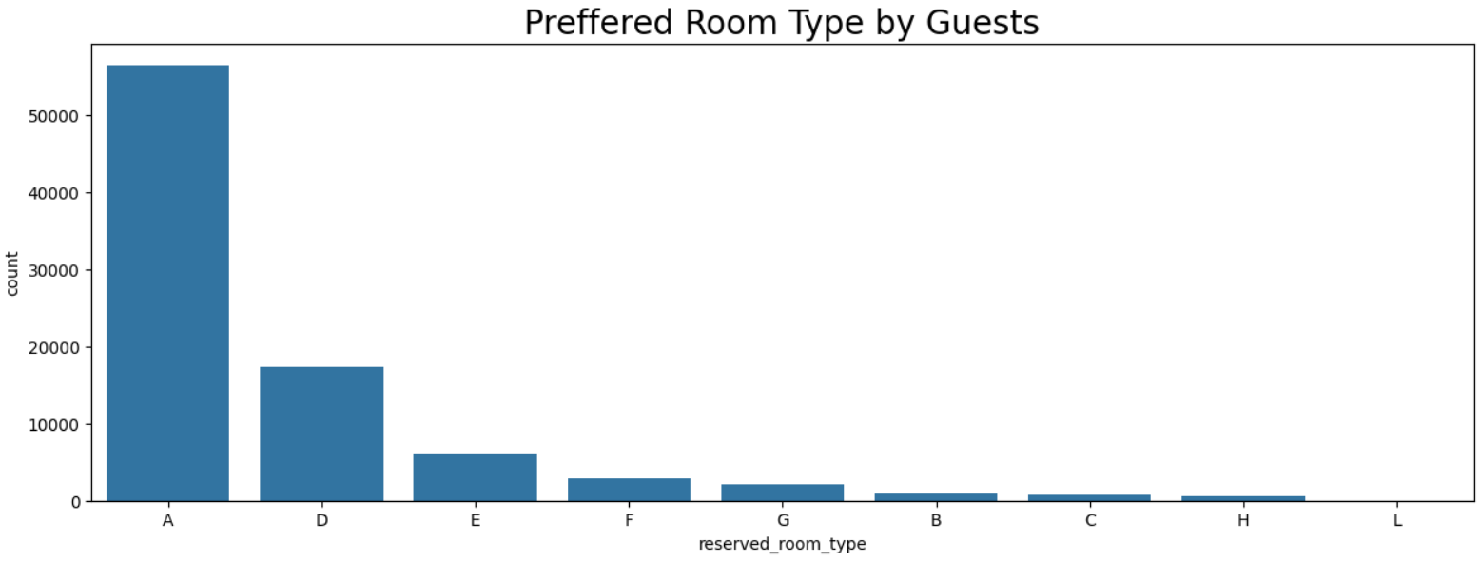
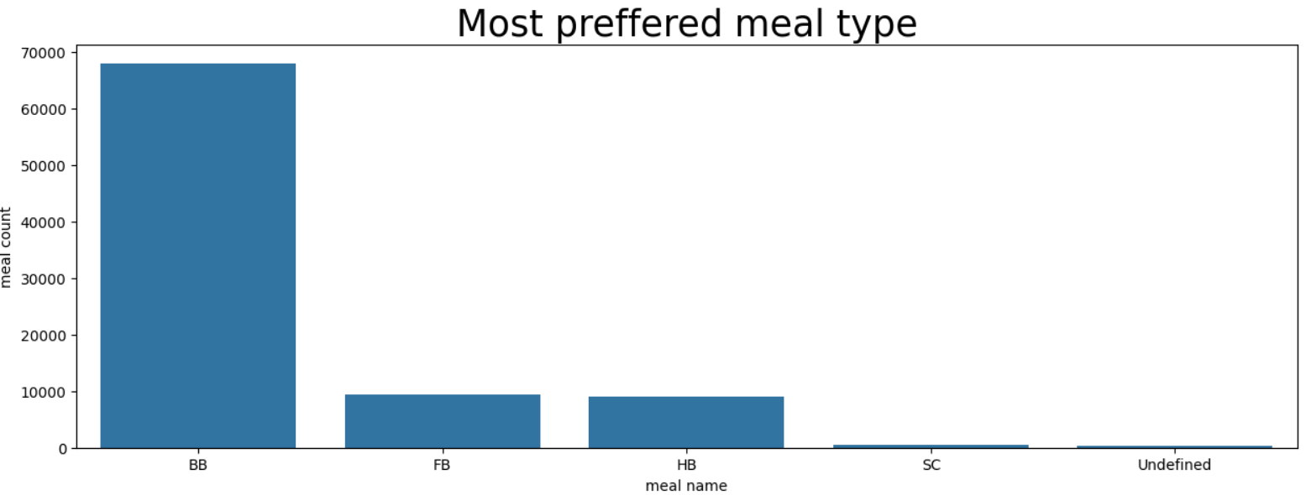
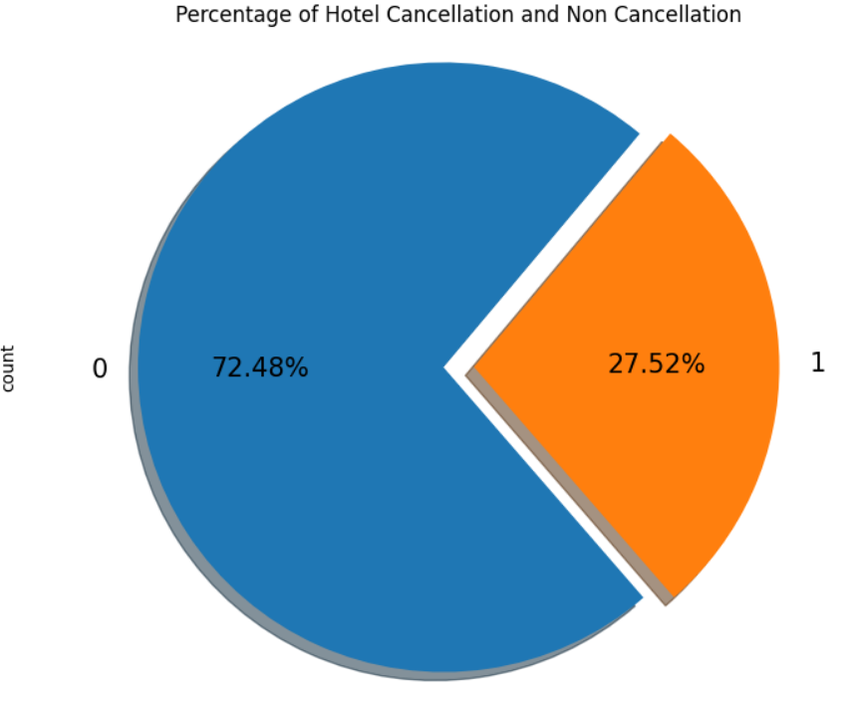
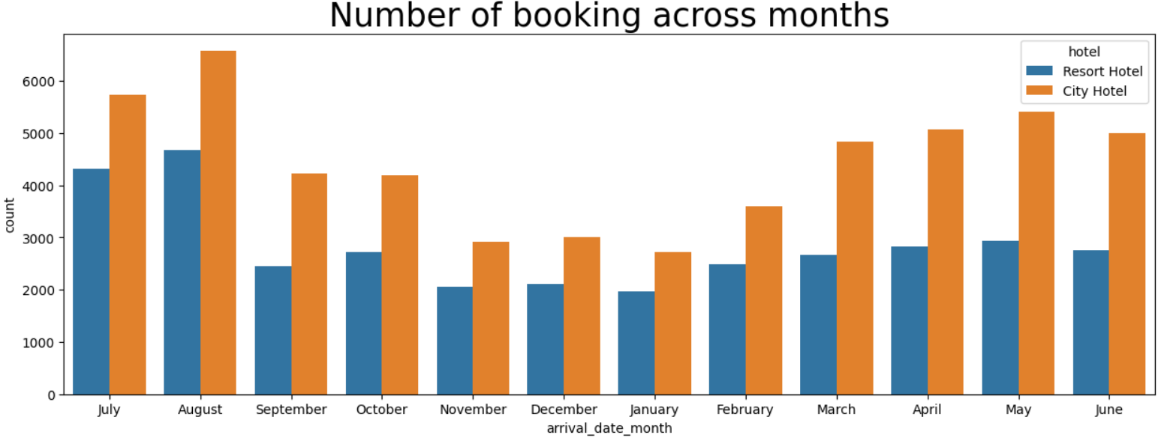
RESULT

Slide 11
CONCLUSION
Inorder to achieve the business objective, I would suggest the client to make the price dynamic and introduce offers and packages to attract new customers. To retain the existing customers and ensure their repetition the client must introduce a loyalty points program that can be redeemed by the customers in their next bookings. Amenities such as parking spaces, kid’s corners, and a free internet connection can be provided to increase the number of bookings.

Slide 12
FUTURE SCOPE
The proposed solution lays the foundation for ongoing advancements in the realm of hotel reservation optimization. Here are key areas for future exploration and enhancement.
Real-time Predictions:
Move towards real-time predictive models that account for instant changes in demand, external events and other dynamic factors to provide users with up-to-the-minute insights for booking decisions.
Personalization and Customization:
Enhance the predictive models to offer more personalized recommendations by considering individual guest preferences, loyalty history, and user-specific requirements, providing a tailored experience for each traveler.

Slide 13
REFERENCES
http://www.Kaggle.com/datasets
http://pandas.pydata.org/pandas-docs/stable/user_guide/index.html
http://seaborn.pydata.org/
http://matplotlib.org/stable/contents.html

Slide 14
THANK YOU

